Slide 1

DIGITAL SIGNATURE ADDON SAP BUSINESS ONE
Authored By :- Remant Mishra

Slide 2

INTRODUCTION
Overview:
A digital signature add-on in SAP Business One is an enhancement designed to provide security, authenticity, and integrity to digital documents. This feature ensures that documents are signed digitally, confirming the identity of the signer and ensuring that the document has not been altered after signing.
Authored By :- Remant Mishra

Slide 3
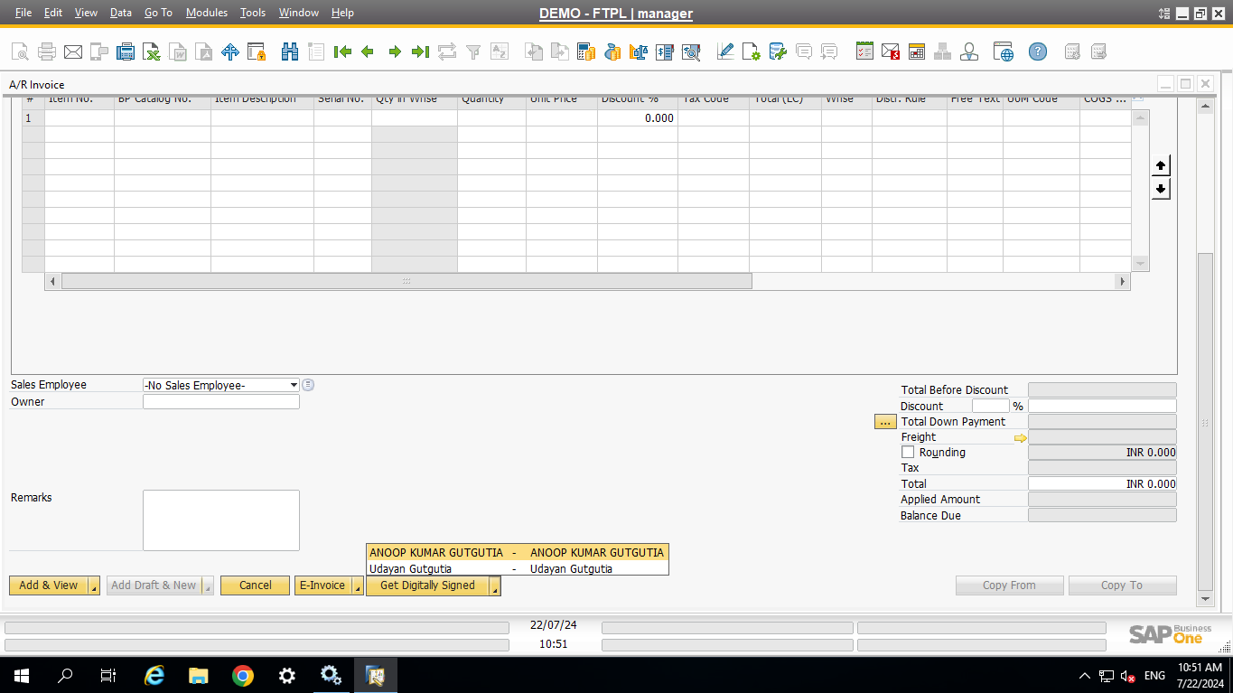
Main Screen – Digital Signature
Silent Features
A Button Combo Named Get Digitally Signed will be appeared on the marketing Documents.
This will be a button combo Containing names of digital signer authorities.
Once User click on the Signer Name it will Show please please wait while while we are processing your request.
Once Done it Digitally signed copy will be saved to attachments in maketing Documents.
Authored By :- Remant Mishra

Slide 4
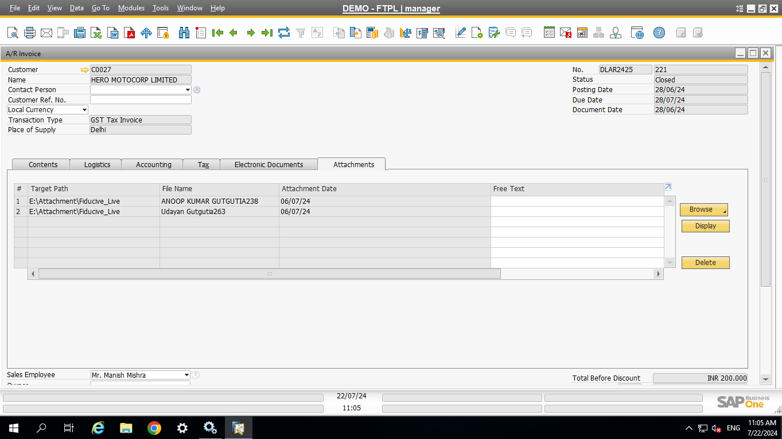
Attachments – Digital Signature
Silent Features
Attachment will be saved by the name of signer + Docentry.pdf.
Once user will Double Click on attachment it will be shown on default pdf viewer.
You cannot Duplicate the same signer and Document .
Authored By :- Remant Mishra

Slide 5
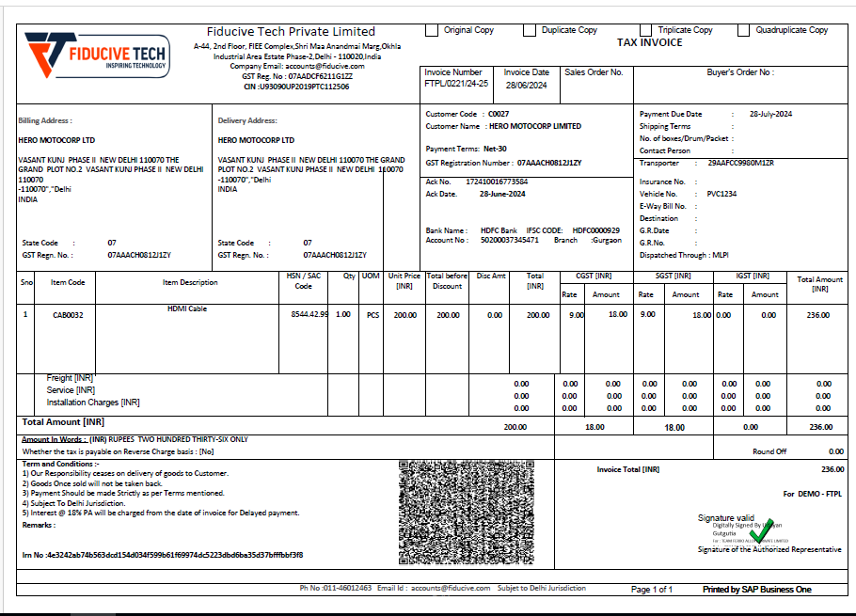
Digitally Signed Copy – Digital Signature
Authored By :- Remant Mishra

Slide 6
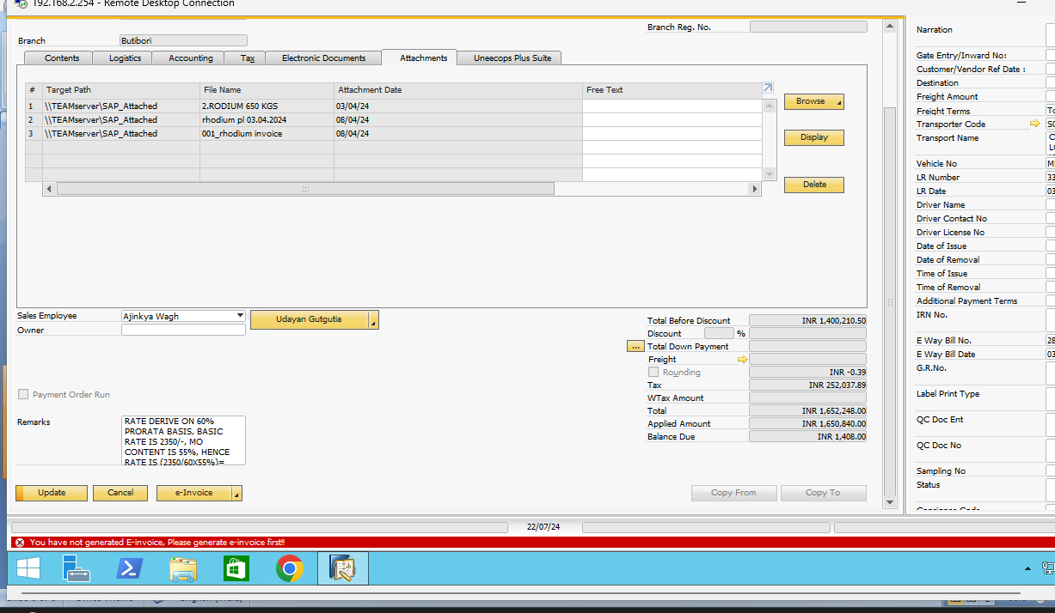
Validations – Digital Signature
Validations
For Domestic invoices and credit memos you cannot digitally sign it untill , you didn’t generate e-invoice of it.
For Export invoices it is permitted.
Perfect sigfner based on branches validations also there.
Authored By :- Remant Mishra

Slide 7
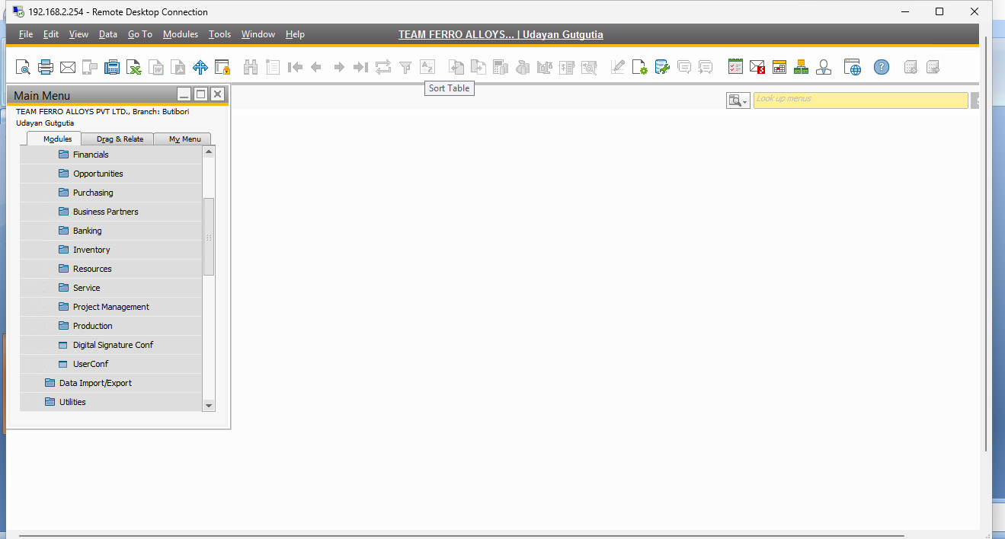
Configuration – Digital Signature
Configuration
some of the basic confguration to sign the documents digitally, where we can manage different layouts to sign based on the layout code .
The Layout code configured here will be used for Digital signature.
It can be defined for both types of Document like Itemised,service etc.
You can also change layouts code time to time as per your requirement.
Authored By :- Remant Mishra

Slide 8
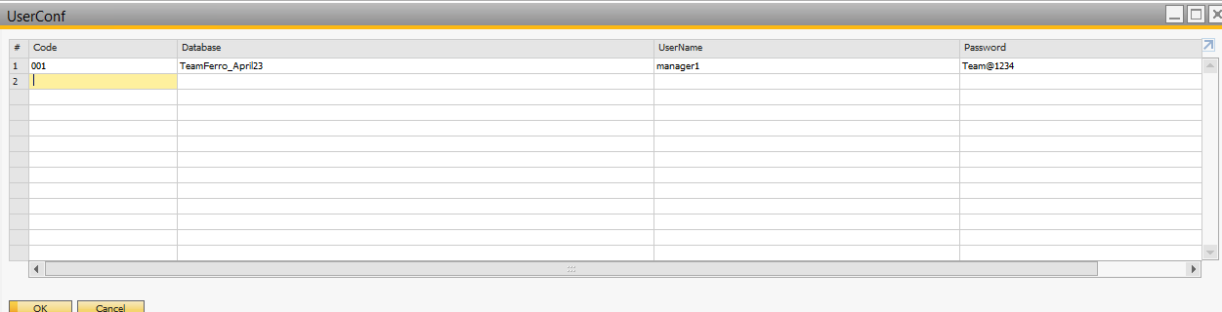
User-Configuration – Digital Signature
Configuration
In this configuration you will mange the user you are using for api gateway service and Digital signature
Authored By :- Remant Mishra

Slide 9


Thank You!
SAP is Backbone ! REEDHAM IT SOLUTION MAKES IT POSSIBLE
Phone : +91 9811596533
E-Mail : info@reedhamitsolution.com
Website: reedhamitsolution.com
Head Office: B-125, DDA SHED, OKHLA PHASE-1, NEW DELHI- 110020

